Slide 1
Introduction to Data Analytics
Lecture 4
Professor Pottenger

Slide 2
Credibility:
Evaluating what’s been learned

Slide 3
Evaluation: the key to success
How predictive is the model we learned?
Error on the training data is not a good indicator of performance on future data
Simple solution that can be used if lots of (labeled) data is available:
Split data into training and test set
However: (labeled) data is usually limited
More sophisticated techniques need to be used

Slide 4
Issues in evaluation
Statistical reliability of estimated differences in performance (→ significance tests)
Choice of performance measure:
Number of correct classifications
Accuracy of probability estimates
Error in numeric predictions
Costs assigned to different types of errors
Many practical applications involve costs

Slide 5
Training and testing I
Natural performance measure for classification problems: error rate
Success: instance’s class is predicted correctly
Error: instance’s class is predicted incorrectly
Error rate: proportion of errors made over the whole set of instances
Resubstitution error: error rate obtained from the training data
Resubstitution error is (hopelessly) optimistic!

Slide 6
Training and testing II
Test set: set of independent instances that have played no part in formation of classifier
Assumption: both training data and test data are representative samples of the underlying problem
Test and training data may differ in nature
Example: classifiers built using customer data from two different towns A and B
To estimate performance of classifier from town A in completely new town, test it on data from B
Notes:
Auto insurance laws in NJ vs. everywhere else.

Slide 7
A note on parameter tuning
It is important that the test data is not used in any way to create the classifier
Some learning schemes operate in two stages:
Stage 1: builds the basic structure
Stage 2: optimizes parameter settings
The test data can’t be used for parameter tuning!
Proper procedure uses three sets: training data, validation data, and test data
Validation data is used to optimize parameters

Slide 8
Making the most of the data
Once evaluation is complete, all the data can be used to build the final classifier
Generally, the larger the training data the better the classifier (but returns diminish)
The larger the test data the more accurate the error estimate
Holdout procedure: method of splitting original data into training and test set
Dilemma: ideally we want both, a large training and a large test set

Slide 9
Predicting performance
Assume the estimated error rate is 25%. How close is this to the true error rate?
Depends on the amount of test data
Prediction is just like tossing a (biased!) coin
“Head” is a “success”, “tail” is an “error”
In statistics, a succession of independent events like this is called a Bernoulli process
Statistical theory provides us with confidence intervals for the true underlying proportion

Slide 10
Confidence intervals
We can say: p lies within a certain specified interval with a certain specified confidence
Example: S=750 successes in N=1000 trials
Estimated success rate: 75%
How close is this to true success rate p?
Answer: with 80% confidence p in [73.2,76.7]
Another example: S=75 and N=100
Estimated success rate: 75%
With 80% confidence p in [69.1,80.1]

Slide 11
Mean and variance
Mean and variance for a Bernoulli trial: p, p (1–p)
Expected success rate f=S/N
Mean and variance for f : p, p (1–p)/N
For large enough N, f follows a Normal distribution
c% confidence interval [–z <= X <= z] for random variable with 0 mean is given by:
With a symmetric distribution:

Slide 12
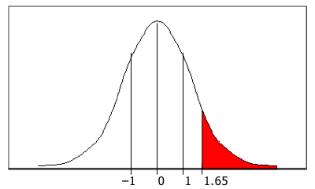
Confidence limits
Confidence limits for the normal distribution with 0 mean and a variance of 1:
Thus:
To use this we have to reduce our random variable f to have 0 mean and unit variance
Pr[X ≥ z]
z
0.1%
3.09
0.5%
2.58
1%
2.33
5%
1.65
10%
1.28
20%
0.84
–1 0 1 1.65
40%
0.25

Slide 13
Transforming f
Transformed value for f : (i.e. subtract the mean and divide by the standard deviation)
Resulting equation:
Solving for p :

Slide 14
Examples
f = 75%, N = 1000, c = 80% (so that z = 1.28):
f = 75%, N = 100, c = 80% (so that z = 1.28):
Note that normal distribution assumption is only valid for large N (i.e. N > 100)
f = 75%, N = 10, c = 80% (so that z = 1.28): (should be taken with a grain of salt)

Slide 15
Holdout estimation
What shall we do if the amount of data is limited?
The holdout method reserves a certain amount for testing and uses the remainder for training
Usually: one third for testing, the rest for training
Problem: the samples might not be representative
Example: class might be missing in the test data
Advanced version uses stratification
Ensures that each class is represented with approximately equal proportions in both subsets (uses ‘random’ sampling)

Slide 16
Repeated holdout method
Holdout estimate can be made more reliable by repeating the process with different sub-samples
In each iteration, a certain proportion is randomly selected for training (possibly with stratification)
The error rates on the different iterations are averaged to yield an overall error rate
This is called the repeated holdout method
Still not optimum: the different test sets overlap
Can we prevent overlapping?

Slide 17
Cross-validation
Cross-validation avoids overlapping test sets
First step: data is split into k subsets of equal size
Second step: each subset in turn is used for testing and the remainder for training
This is called k-fold cross-validation
Often the subsets are stratified before the cross-validation is performed
The error estimates are averaged to yield an overall error estimate

Slide 18
More on cross-validation
Standard method for evaluation: stratified ten-fold cross-validation
Why ten? Extensive experiments have shown that this is the best choice to get an accurate estimate
There is also some theoretical evidence for this
Stratification reduces the estimate’s variance
Even better: repeated stratified cross-validation
E.g. ten-fold cross-validation is repeated ten times and results are averaged (reduces the variance)

Slide 19
Leave-one-out cross-validation
Leave-one-out cross-validation is a particular form of cross-validation:
The number of folds is set to the number of training instances
I.e., a classifier has to be built n times, where n is the number of training instances
Makes maximum use of the data
No random sub-sampling involved
Very computationally expensive

Slide 20
Leave-one-out-cross-validation and Stratification
Disadvantage of Leave-One-Out-CV: stratification is not possible
It guarantees a non-stratified sample because there is only one instance in the test set!
Extreme example: random dataset split equally into two classes
Best inducer predicts majority class
50% accuracy on fresh data
Leave-One-Out-CV estimate is 100% error!

Slide 21
The bootstrap
CV uses sampling without replacement
The same instance, once selected, can not be selected again for a particular training/test set
The bootstrap is an estimation method that uses sampling with replacement to form the training set
A dataset of n instances is sampled n times with replacement to form a new dataset of n instances
This data is used as the training set
The instances from the original dataset that don’t occur in the new training set are used for testing

Slide 22
The 0.632 bootstrap
This method is also called the 0.632 bootstrap
A particular instance has a probability of 1-1/n of not being picked
Thus its probability of ending up in the test data is:
This means the training data will contain approximately 63.2% of the instances

Slide 23
Estimating error with the bootstrap
The error estimate on the test data will be very pessimistic
It contains only ~37% of the instances
Thus it is combined with the resubstitution error:
The resubstitution error gets less weight than the error on the test data
Process is repeated several times, with different replacement samples, and the results averaged

Slide 24
More on the bootstrap
It is probably the best way of estimating performance for very small datasets
However, it has some problems
Consider a dataset with yes/no class labels
A perfect model that memorizes the set will achieve 0% resubstitution error and ~50% error on test data
Bootstrap estimate for this classifier:
True expected error: 50%

Slide 25
Comparing data mining schemes
Frequent question: which of two learning schemes performs better?
Note: this is domain dependent!
Obvious way: compare 10-fold CV estimates
Generally sufficient in applications (we don't loose if the chosen method is not truly better)
However, what about machine learning research?
Need to show convincingly that a particular method works better

Slide 26
Comparing schemes II
Want to show that scheme A is better than scheme B in a particular domain
For a given amount of training data
On average, across all possible training sets
Let's assume we have an infinite amount of data from the domain:
Sample infinitely many dataset of specified size
Obtain cross-validation estimate on each dataset for each scheme
Check if mean accuracy for scheme A is better than mean accuracy for scheme B

Slide 27
Paired t-test
In practice we have limited data and a limited number of estimates for computing the mean
Student’s t-test tells whether the means of two samples are significantly different
In our case the samples are cross-validation estimates for different datasets from the domain
Use a paired t-test because the individual samples are paired
The same cross-validation is applied twice

Slide 28
Distribution of the means
x₁ x₂ … x_{k} and y₁ y₂ … y_{k} are the 2k samples for the k different datasets
m_{x} and m_{y} are the means
With enough samples, the mean of a set of independent samples is normally distributed
Estimated variances of the means are s_{x}²/k and s_{y}²/k
If m_{x} and m_{y} are the true means then are approximately normally distributed with mean 0, variance 1

Slide 29
Student’s distribution
With small samples (k < 100) the mean follows Student’s distribution with k–1 degrees of freedom
Confidence limits:
9 degrees of freedom normal distribution
Pr[X ≥ z]
z
Pr[X ≥ z]
z
0.1%
4.30
0.1%
3.09
Assuming
we have
10 estimates
0.5%
3.25
0.5%
2.58
1%
2.82
1%
2.33
5%
1.83
5%
1.65
10%
1.38
10%
1.28
20%
0.88
20%
0.84

Slide 30
Distribution of the differences
Let m_{d} = m_{x} – m_{y}
The difference of the means (m_{d}) also has a Student’s distribution with k–1 degrees of freedom
Let s_{d}² be the variance of the difference
The standardized version of m_{d} is called the t-statistic:
We use t to perform the t-test

Slide 31
Performing the test
Fix a significance level
If a difference is significant at the a% level, there is a (100-a)% chance that the true means differ
Divide the significance level by two because the test is two-tailed
I.e. the true difference can be +ve or – ve
Look up the value for z that corresponds to a/2
If t  –z or t z then the difference is significant
I.e. the null hypothesis (that the difference is zero) can be rejected

Slide 32
Unpaired observations
If the CV estimates are from different datasets, they are no longer paired (or maybe we have k estimates for one scheme, and j estimates for the other one)
Then we have to use an un paired t-test with min(k , j) – 1 degrees of freedom
The estimate of the variance of the difference of the means becomes:

Slide 33
Dependent estimates
We assumed that we have enough data to create several datasets of the desired size
Need to re-use data if that's not the case
E.g. running cross-validations with different randomizations on the same data
Samples become dependent  insignificant differences can become significant
A heuristic test is the corrected resampled t-test:
Assume we use the repeated hold-out method, with n₁ instances for training and n₂ for testing
New test statistic is:

Slide 34
Predicting probabilities
Performance measure so far: success rate
Also called 0-1 loss function:
Most classifiers produces class probabilities
Depending on the application, we might want to check the accuracy of the probability estimates
0-1 loss is not the right thing to use in those cases

Slide 35
Quadratic loss function
p₁ … p_{k} are probability estimates for an instance
c is the index of the instance’s actual class
a₁ … a_{k} = 0, except for a_{c} which is 1
Quadratic loss is:
Want to minimize
Can show that this is minimized when p_{j} = p_{j}*, the true probabilities

Slide 36
Informational loss function
The informational loss function is –log(p_{c}), where c is the index of the instance’s actual class
Number of bits required to communicate the actual class
Let p₁* … p_{k}* be the true class probabilities
Then the expected value for the loss function is:
Justification: minimized when p_{j} = p_{j}*
Difficulty: zero-frequency problem

Slide 37
Discussion
Which loss function to choose?
Both encourage honesty
Quadratic loss function takes into account all class probability estimates for an instance
Informational loss focuses only on the probability estimate for the actual class
Quadratic loss is bounded: it can never exceed 2
Informational loss can be infinite
Informational loss is related to MDL principle

Slide 38
Counting the cost
In practice, different types of classification errors often incur different costs
Examples:
Terrorist profiling: “Not a terrorist” correct 99.99% of the time
Loan decisions
Oil-slick detection
Fault diagnosis
Promotional mailing

Slide 39
Counting the cost
The confusion matrix:
There are many other types of cost!
E.g.: cost of collecting training data
Predicted class
Yes
No
Actual class
Yes
True positive
False negative
No
False positive
True negative

Slide 40
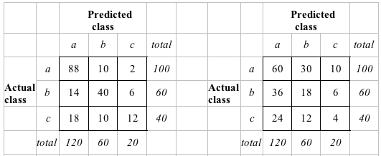
Aside: the kappa statistic
Two confusion matrices for a 3-class problem: actual predictor (left) vs. random predictor (right)
Number of successes: sum of entries in diagonal (D)
Kappa statistic: measures relative improvement over random predictor

Slide 41
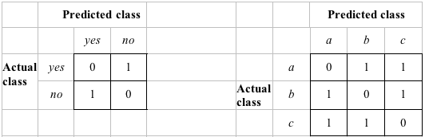
Classification with costs
Two cost matrices:
Success rate is replaced by average cost per prediction
Cost is given by appropriate entry in the cost matrix

Slide 42
Cost-sensitive classification
Can take costs into account when making predictions
Basic idea: only predict high-cost class when very confident about prediction
Given: predicted class probabilities
Normally we just predict the most likely class
Here, we should make the prediction that minimizes the expected cost
Expected cost: dot product of vector of class probabilities and appropriate column in cost matrix
Choose column (class) that minimizes expected cost

Slide 43
Cost-sensitive learning
So far we haven't taken costs into account at training time
Most learning schemes do not perform cost-sensitive learning
They generate the same classifier no matter what costs are assigned to the different classes
Example: standard decision tree learner
Simple methods for cost-sensitive learning:
Resampling of instances according to costs
Weighting of instances according to costs
Some schemes can take costs into account by varying a parameter, e.g. naïve Bayes

Slide 44
Lift charts
In practice, costs are rarely known
Decisions are usually made by comparing possible scenarios
Example: promotional mailout to 1,000,000
Situation 1: classifier predicts that 0.1% of all households will respond
Situation 2: classifier predicts that 0.4% of the 100,000 most promising households will respond
A lift chart allows for a visual comparison
In a lift chart, the x axis is sample size and y axis is number of true positives

Slide 45
Generating a lift chart
Sort instances according to predicted probability of being positive:
x axis is sample size y axis is number of true positives
Predicted probability
Actual class
1
0.95
Yes
2
0.93
Yes
3
0.93
No
4
0.88
Yes
…
…
…

Slide 46
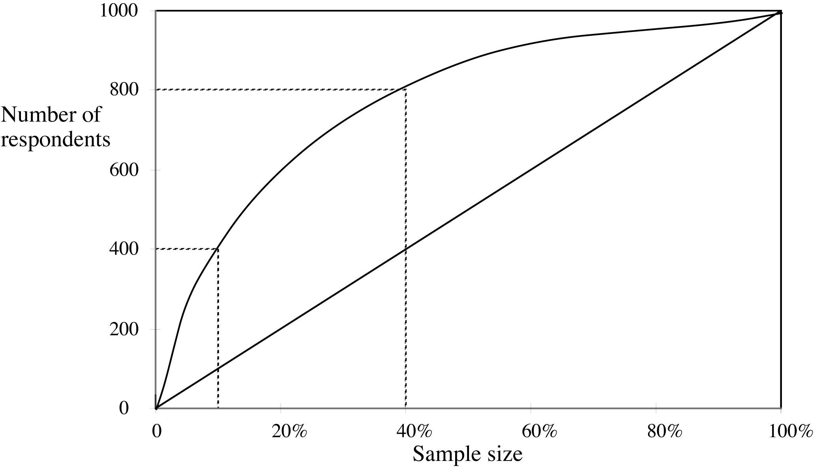
A hypothetical lift chart
Lift factor = 4
Lift factor = ?
Notes:
Which point on the curve is best? How could lift be used in association rule mining to counter the bias of precision for ‘popular’ items like milk? Think about the baseline… if the baseline is the number of milk purchases independent of other items, we could then focus on those who purchased both milk and eggs, and see if we get more milk purchases than average for this group. If so, this tells us that the egg purchasing customers are ‘more promising’ in that collectively they more often buy milk.

Slide 47
Generating a lift chart for
Naïve Bayes
Instances are sorted according to their predicted probability of being a true positive:
Repeated sampling will yield a curve – a lift chart
Rank | Predicted probability | Actual class
1 | 0.95 | Yes
2 | 0.93 | Yes
3 | 0.93 | No
4 | 0.88 | Yes
… | … | …
Notes:
If we choose the sub-sample as the first two instances (rank 1 and 2), then the success proportion is 2 instances divided by 2, the total number of actual ‘yes’ classes = 2/2 = 1. The success proportion for the ‘entire set’ (if we choose the first four instances as our entire set) is 3/4. The lift is then simply (3/4)/k, where k is the ‘random’ accuracy for the entire training set. Success proportion is simply precision (TP/(TP+FP)), and the ‘random’ accuracy is the overall number of positive (e.g., ‘yes’) instances divided by the total number of instances.

Slide 48
ROC curves
ROC curves are similar to lift charts
“ROC” stands for “receiver operating characteristic”
Used in signal detection to show tradeoff between hit rate and false alarm rate over a noisy channel
Differences with lift chart:
y axis shows percentage of true positives in sample (rather than absolute number)
x axis shows percentage of false positives in sample (rather than sample size)

Slide 49
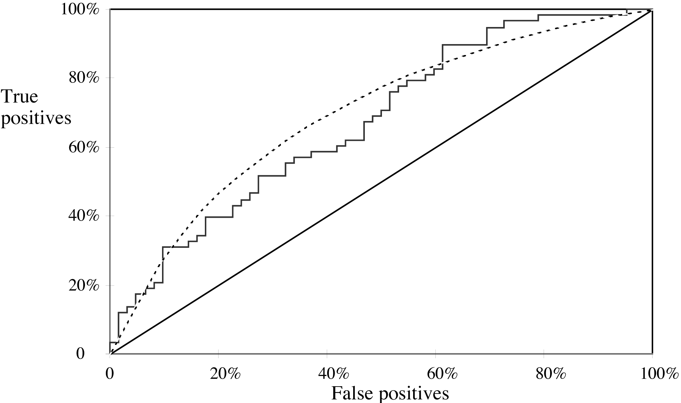
A sample ROC curve

Slide 50
Cross-validation and ROC curves
Simple method of getting a ROC curve using cross-validation:
Collect probabilities for instances in test folds
Sort instances according to probabilities
This method is implemented in WEKA
However, this is just one possibility
The method described in the book generates an ROC curve for each fold and averages them

Slide 51
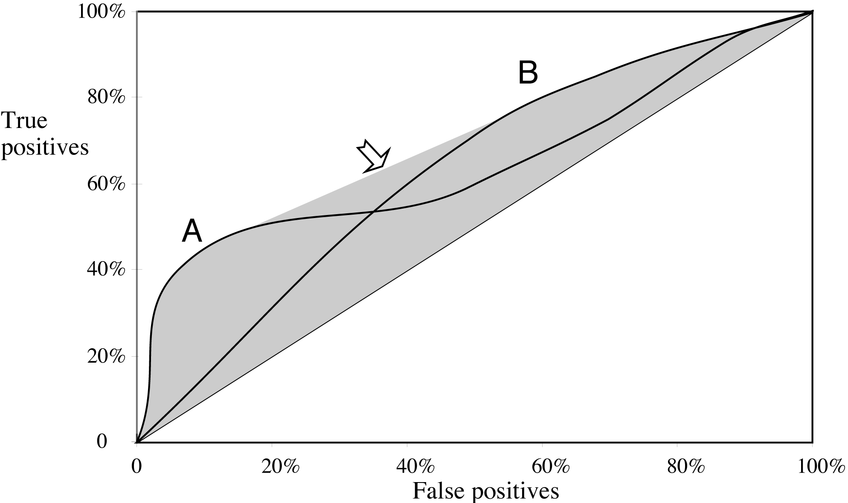
ROC curves for two schemes

Slide 52
The convex hull
Given two learning schemes we can achieve any point on the convex hull!
TP and FP rates for scheme A: t₁ and f₁
TP and FP rates for scheme B: t₂ and f₂
If scheme A is used to predict 100×q% of 100 cases and scheme B for the rest, then we get:
TP rate for combined scheme: q × t₁+(1-q) × t₂
FP rate for combined scheme: q × f₁+(1-q) × f₂

Slide 53
More measures...
Percentage of retrieved documents that are relevant: precision=TP/(TP+FP)
Percentage of relevant documents that are returned: recall =TP/(TP+FN)
Precision/recall curves have hyperbolic shape
Summary measures: average precision at 20%, 50% and 80% recall (three-point average recall)
F-measure=(2 × recall × precision)/(recall+precision)
sensitivity × specificity = (TP / (TP + FN)) × (TN / (FP + TN))
Area under the ROC curve (AUC): probability that randomly chosen positive instance is ranked above randomly chosen negative one

Slide 54
Summary of measures
 | Domain | Plot | Explanation
Lift chart | Marketing and text/data mining | TP vs. Subset size | TP (TP+FP)/ (TP+FP+TN+FN)
ROC curve | Communications and text/data mining | TP rate FP rate | TP/(TP+FN) FP/(FP+TN)
Recall-precision curve | Information retrieval and text/data mining | Recall Precision | TP/(TP+FN) TP/(TP+FP)
But don’t forget success rate: (TP+TN)/(TP+TN+FP+FN)!!
Notes:
Think about a machine learning application with multiple (three or more) labels for the class… how would success rate (or, conversely, error rate) be computed in this case? (Hint: does TN have the same meaning? What is on the diagonal of a confusion matrix in this case?)

Slide 55
Counting the costs
In practice, different types of classification errors often incur different costs just as correct classifications result in different profits
Examples:
Predicting when cows are in heat (“in estrus”)
“Not in estrus” correct 97% of the time
Loan decisions
Oil-slick detection
Fault diagnosis
Promotional mailing
Notes:
What’s your intuition on the cost of a false negative in each of the cases above? A false positive?

Slide 56
Taking costs into account
The confusion matrix:
There many other types of costs!
E.g.: cost of collecting training data
 |  | Predicted class
 |  | Yes | No
Actual class | Yes | True positive | False negative
 | No | False positive | True negative
Notes:
Consider the correct predictions now (true positives and true negatives) – what is the profit in correct classification (as opposed to the cost of incorrect classification)?

Slide 57
Cost-sensitive learning
Most learning schemes do not perform cost-sensitive learning
They generate the same classifier no matter what costs are assigned to the different classes
Example: standard decision tree learner
Simple methods for cost-sensitive learning:
Resampling of instances according to costs
Weighting of instances according to costs
Some schemes are inherently cost-sensitive, e.g. Naïve Bayes

Slide 58
Comparing data mining schemes
Frequent situation: we want to know which one of two learning schemes performs better
Note: this is domain dependent!
Obvious way: compare 10-fold CV estimates
Problem: variance in estimate
Variance can be reduced using repeated CV
However, we still don’t know whether the results are reliable

Slide 59
Significance tests
Significance tests tell us how confident we can be that there really is a difference
Null hypothesis: there is no “real” difference
Alternative hypothesis: there is a difference
A significance test measures how much evidence there is in favor of rejecting the null hypothesis
Let’s say we are using 10 times 10-fold CV
Then we want to know whether the two means of the 10 CV estimates are significantly different

Slide 60
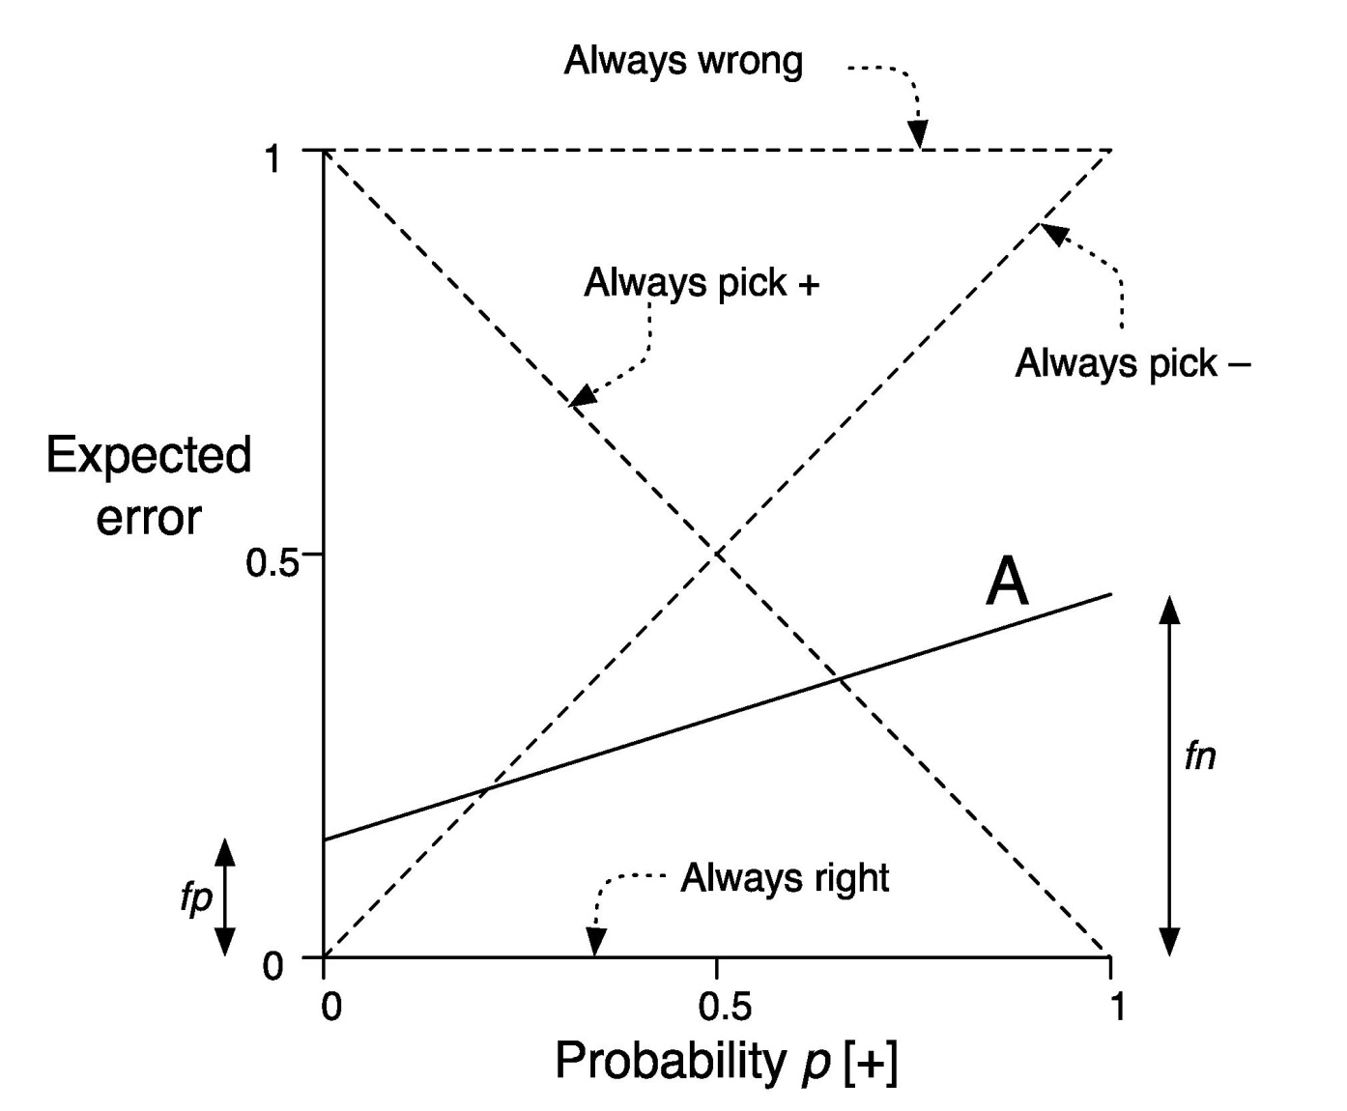
Cost curves
Cost curves plot expected costs directly
Example for case with uniform costs (i.e. error):

Slide 61
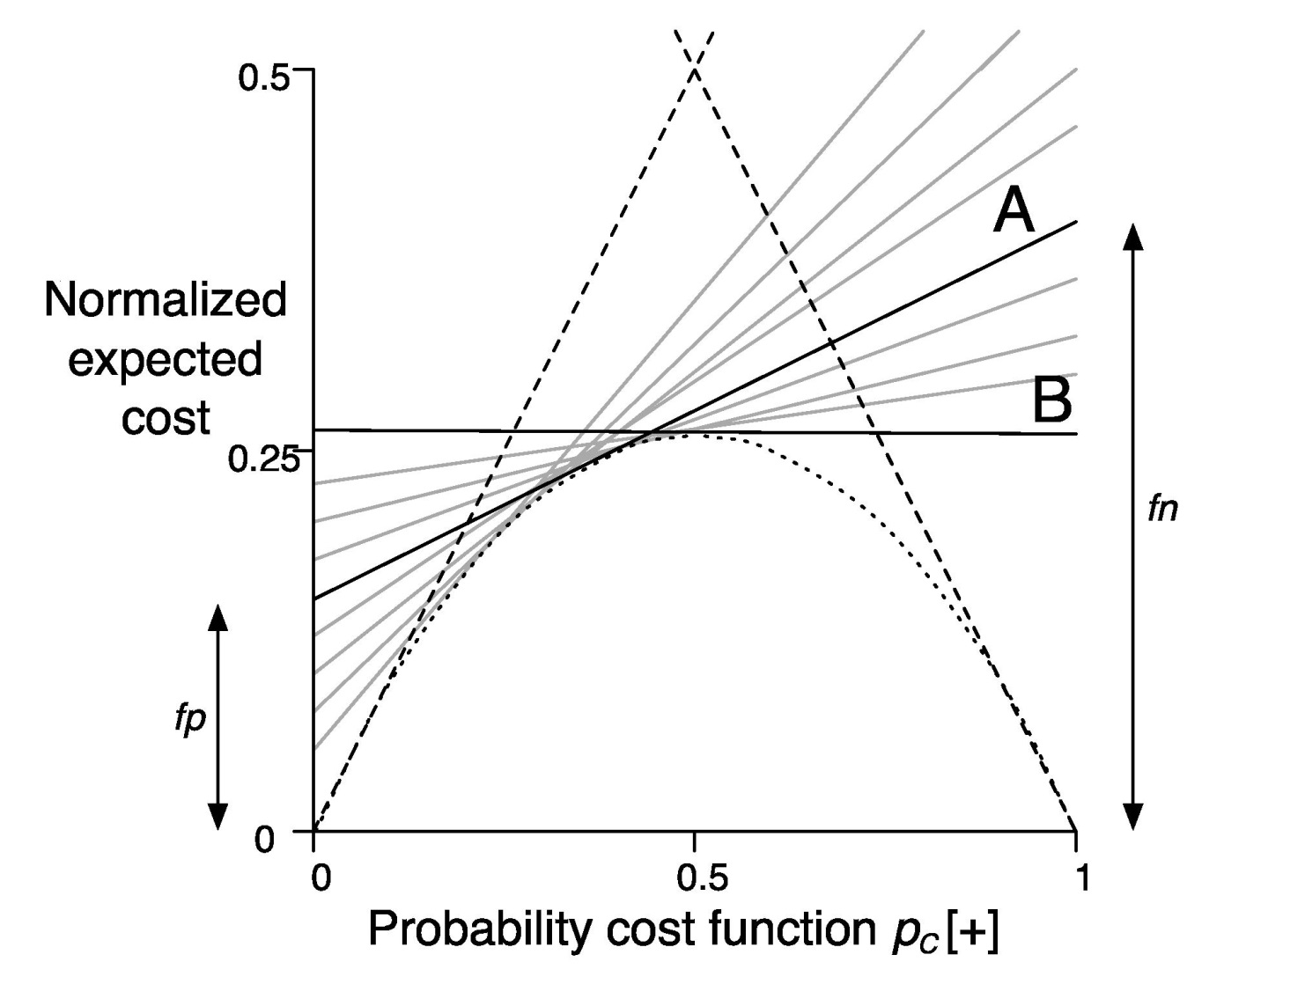
Cost curves: example with costs

Slide 62
Evaluating numeric prediction
Same strategies: independent test set, cross-validation, significance tests, etc.
Difference: error measures
Actual target values: a₁, a₂,…,a_{n}
Predicted target values: p₁, p₂,…,p_{n}
Most popular measure: mean-squared error
Easy to manipulate mathematically

Slide 63
Other measures
The root mean-squared error:
The mean absolute error is less sensitive to outliers than the mean-squared error:
Sometimes relative error values are more appropriate (e.g. 10% for an error of 50 when predicting 500)

Slide 64
Improvement on the mean
Often we want to know how much the scheme improves on simply predicting the average
The relative squared error is ( ):
The relative absolute error is:

Slide 65
The correlation coefficient
Measures the statistical correlation between the predicted values and the actual values
Scale independent, between –1 and +1
Good performance leads to large values!

Slide 66
Which measure?
Best to look at all of them
Often it doesn’t matter
Example:
 | A | B | C | D
Root mean-squared error | 67.8 | 91.7 | 63.3 | 57.4
Mean absolute error | 41.3 | 38.5 | 33.4 | 29.2
Root relative squared error | 42.2% | 57.2% | 39.4% | 35.8%
Relative absolute error | 43.1% | 40.1% | 34.8% | 30.4%
Correlation coefficient | 0.88 | 0.88 | 0.89 | 0.91

Slide 67
The MDL principle
MDL stands for minimum description length
The description length is defined as:
space required to describe a theory
+
space required to describe the theory’s mistakes
In our case the theory is the classifier and the mistakes are the errors on the training data
Aim: we want a classifier with minimal DL
MDL principle is a model selection criterion

Slide 68
Model selection criteria
Model selection criteria attempt to find a good compromise between:
The complexity of a model
Its prediction accuracy on the training data
Reasoning: a good model is a simple model that achieves high accuracy on the given data
Also known as Occam’s Razor: the best theory is the smallest one that describes all the facts

Slide 69
Elegance vs. errors
Theory 1: very simple, elegant theory that explains the data almost perfectly
Theory 2: significantly more complex theory that reproduces the data without mistakes
Theory 1 is probably preferable
Classical example: Kepler’s three laws on planetary motion
Less accurate than Copernicus’s latest refinement of the Ptolemaic theory of epicycles

Slide 70
MDL and compression
The MDL principle is closely related to data compression:
It postulates that the best theory is the one that compresses the data the most
I.e. to compress a dataset we generate a model and then store the model and its mistakes
We need to compute (a) the size of the model and (b) the space needed for encoding the errors
(b) is easy: can use –p log p informational loss function
For (a) we need a method to encode the model

Slide 71
Discussion of the MDL principle
Advantage: makes full use of the training data when selecting a model
Disadvantage 1: appropriate coding scheme/prior probabilities for theories are crucial
Disadvantage 2: no guarantee that the MDL theory is the one which minimizes the expected error
I.e., might result in overfitting!!
Note: Occam’s Razor is an axiom!
Keep all theories that are consistent with the data

Slide 72
MDL and clustering
DL of theory: DL needed for encoding the clusters (e.g. cluster centers)
DL of data given theory: need to encode cluster membership and position relative to cluster (e.g. distance to cluster center)
Works if coding scheme needs less code space for small numbers than for large ones
With nominal attributes, we need to communicate probability distributions for each cluster

Slide 73
Representing clusters II
Probabilistic assignment
Dendrogram
1 2 3
a 0.4 0.1 0.5
b 0.1 0.8 0.1
c 0.3 0.3 0.4
d 0.1 0.1 0.8
e 0.4 0.2 0.4
f 0.1 0.4 0.5
g 0.7 0.2 0.1
h 0.5 0.4 0.1
…
Note: dendron is the Greek word for tree

Slide 74
MDL and Bayes’s Theorem
L[T]=“length” of the theory
L[E|T]=training set encoded wrt the theory
Description length= L[T] + L[E|T]
Bayes’s theorem gives a posteriori probability of a theory given the data:
Equivalent to:
constant

